Slide 1

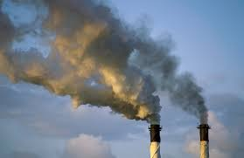
Trends in Electricity Carbon Emissions
Daniel Alvarez
DAT-NYC-44
Final Project
December 2016

Slide 2

Electricity emissions trends
Why do emissions from electricity generation matter?
According to the EPA, the largest source of greenhouse gas emissions from human activities in the US is from burning fossil fuels for electricity (30 percent of 2014 greenhouse gas emissions)
Approximately 67 percent of our electricity comes from burning fossil fuels, mostly coal and natural gas

Slide 3

Background
There has been a change in the production of emissions from electricity generation sources over recent years
Due to:
Technological advances in electricity generation
Increasing regulatory standards to reduce carbon emissions from traditional electricity generation supply sources
Pricing changes for different electricity generation supply sources (e.g. natural gas becoming cheaper relative to coal)
Consumers exercising choice as to where their electricity generation comes from

Slide 4
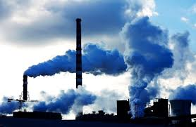
Problem and Hypothesis
Problem
Have CO2 emissions shifted meaningfully across electricity generation suppliers over time?
What will CO2 emissions across electricity generation suppliers look like in the future?
Hypothesis
CO2 emissions have shifted meaningfully to lower emissions electricity generation suppliers
CO2 emissions across electricity generation suppliers should trend lower in future with technological advances, regulatory mandates and consumer choice

Slide 5

Data
Two longitudinal datasets spanning 26 years (1990 – 2015)
US Electric Power Industry Estimated Emissions
Annual CO2, SO2 and NOx emissions from electricity generation
Measured in Metric Tons (Mt) of emissions
Energy sources include: Coal, Geothermal, Natural Gas, Nuclear, Biomass, Other Gases, Petroleum, Wood and Total and Other Sources
US Net Generation
Annual Net generation from electricity power generation
Measured in Megawatthours (MWh) of generation
Energy sources include: Coal, Geothermal, Hydroelectric Conventional, Natural Gas, Nuclear, Other Biomass, Other Gases, Petroleum, Pumped Storage, Solar, Wind, Wood and Other Sources
Both data sets reported at the state and national level and taken from the Energy Information Administration

Slide 6
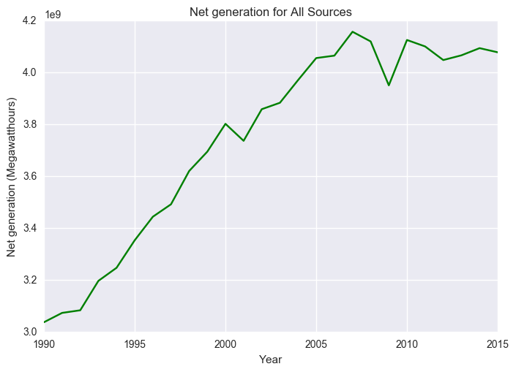
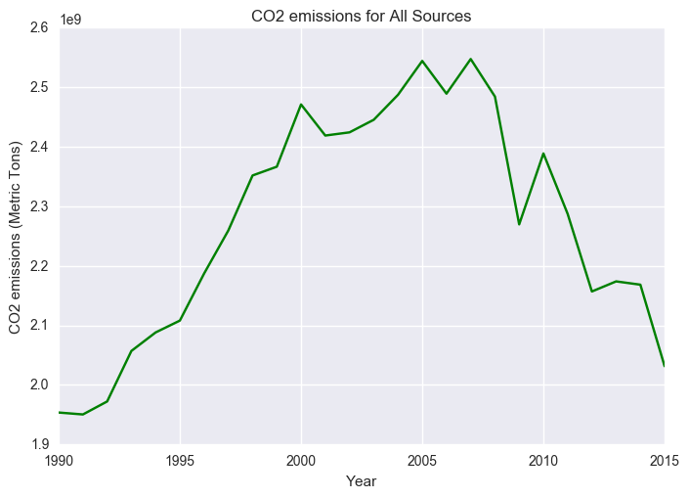
CO2 emissions trends have changed
Net Generation peaked at 4 Million MWh around 2005, yet CO2 emissions have declined since 2007 (2.5 Billion MT)
Notes:
Note stabilizing of net generation around 2007-2008 and dramatic drop in generation around 2009 during the Great Recession.

Slide 7
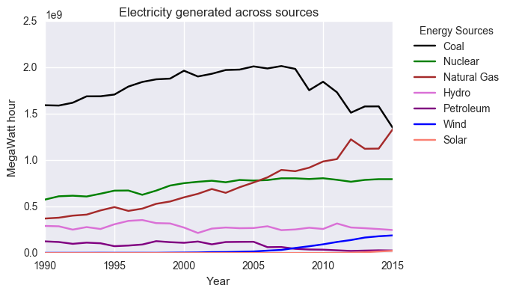
Power generation trends by source
Recent stable levels of annual generation has coincided with declining coal and increasing natural gas-sourced generation
Notes:
Note stabilizing of net generation around 2007-2008 and dramatic drop in generation around 2009 during the Great Recession.

Slide 8
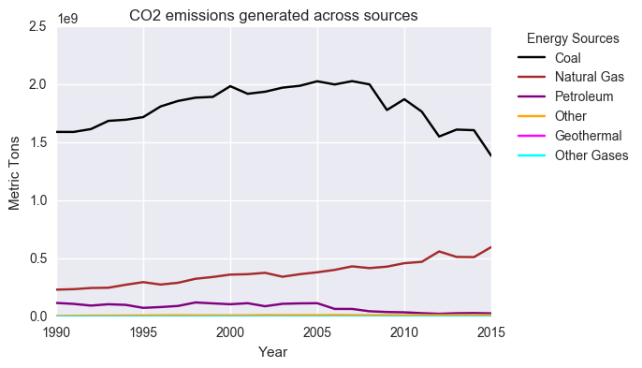
CO2 emissions trends by source
Sharp CO2 emissions declines appears driven by declining coal-sourced CO2 emissions, despite increasing (yet, smaller) emissions from natural gas
Notes:
Note stabilizing of net generation around 2007-2008 and dramatic drop in generation around 2009 during the Great Recession.

Slide 9
CO2 generation efficiency measure
Coal is far and away the highest CO2 emission content source:
The trend towards lower CO2-to-energy sources, such as natural gas, will lead to lower CO2-producing generation in the future, right?
Try to answer this, by:
Merging the two datasets (CO2 emissions and generation)
Creating CO2 metric ton emissions per MWh generated measure (CO2 generation efficiency)
Predict trends and forecast values using time series methods
Fuel source | Pounds of CO2 per million Btu
Coal | 214 - 228
Diesel fuel | 161
Gasoline | 157
Natural gas | 117
Notes:
snuflafogus

Slide 10
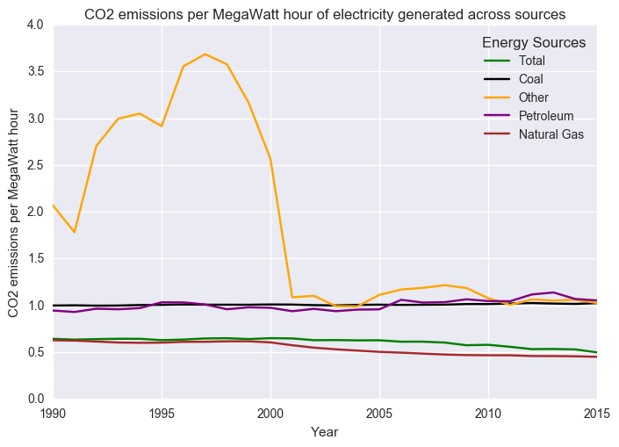
CO2 generation efficiency
Using this measure, we observe that Other sources was a clear outlier in CO2 generation efficiency (outstanding values prior to 2001)
Notes:
“snuffaluffagus” graph.
Other sources includes non-biogenic municipal solid waste, batteries, chemicals, hydrogen, pitch, purchased steam, sulfur, tire-derived fuels, and miscellaneous technologies.

Slide 11
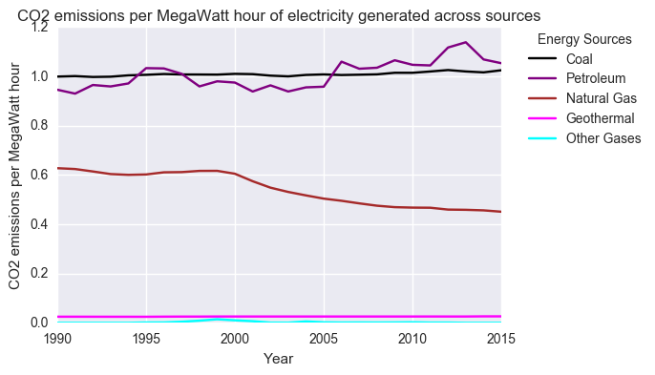
CO2 generation efficiency
Removing Other sources, we better observe variations in the CO2 efficiencies of emitting sources over time: notably, stable coal, decreasing natural gas and oscillating petroleum

Slide 12
CO2 generation efficiency
Removing Other sources, we better observe variations in the CO2 efficiencies of emitting sources over time: notably, stable coal, decreasing natural gas and oscillating petroleum

Slide 13
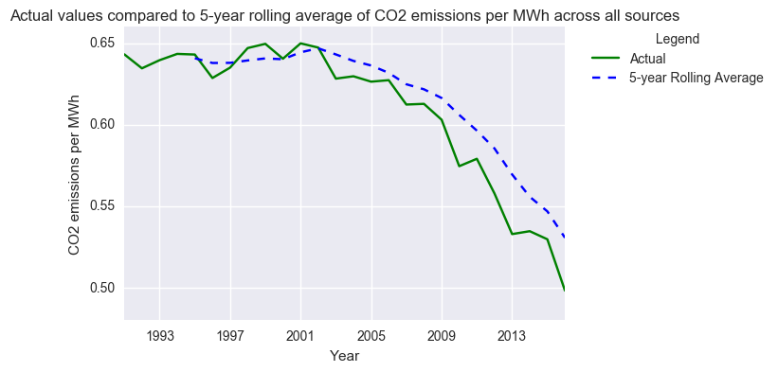
Rolling average trends
Declining trend in CO2 efficiency for total sources starting around 2002. The 5-year rolling average CO2 efficiency is consistently above actual values indicating a strong declining effect post-2002.
Notes:
Plots of rolling average trends smooth out oscillations in CO2 efficiency measures and show the effects of atypical periods

Slide 14
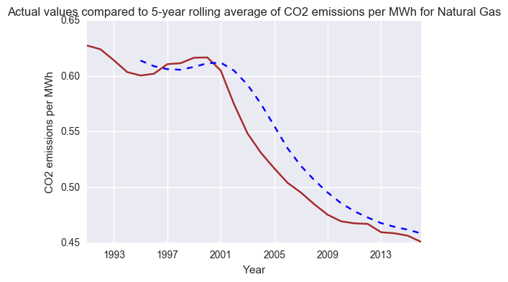
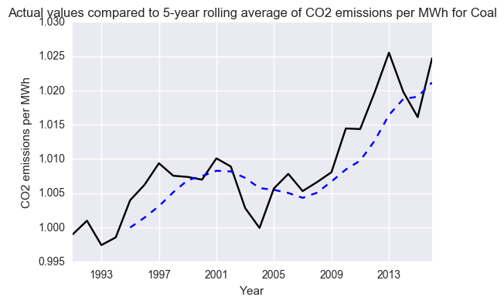
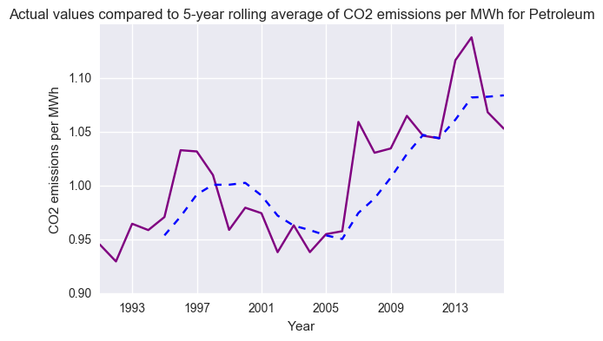
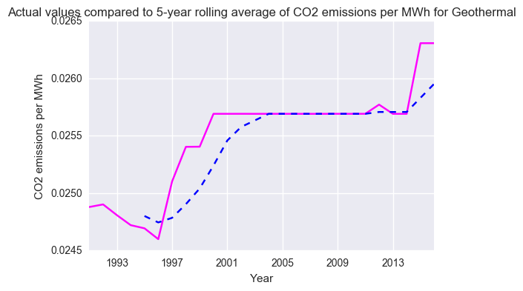
Rolling average trends
Rolling average CO2 efficiency trends for Natural Gas show a clear break from the past starting in 2001. Conversely, we see opposite trends for Coal and Petroleum starting around 2005
Notes:
Plots of rolling average trends smooth out oscillations in CO2 efficiency measures and show the effects of atypical periods.
The above plot shows that the 5-year rolling average of CO2 emissions per MWh for Natural Gas is consistently higher than the actual values from 2001 going forward.
The above plot shows that the 5-year rolling average of CO2 emissions per MWh for Coal is consistently lower than the actual values from 2005 on, with the exception of 2014.
The above plot shows that the 5-year rolling average of CO2 emissions per MWh for Petroleum is consistently lower than the actual values from 2005 on, with the exception of 2014 and 2015.
The above plot shows that the 5-year rolling average of CO2 emissions per MWh for Geothermal is oddly the same as the the actual values from 2005 to 2013, with actual values going higher only 2014 and prior to 2005.

Slide 15
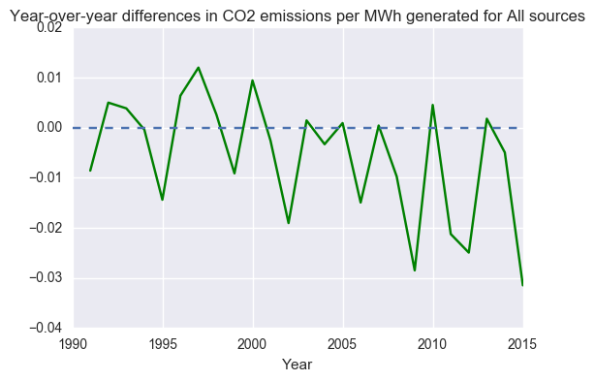
Year-over-year differences
The largest year-over-year declines in CO2 efficiency are observed in most recent years. Conversely, the largest year-over-year increases in CO2 efficiency were observed during the 1990s and year 2000.
Notes:
The above output shows that the largest year-over-year drops in CO2 per MWh of electricity generated (CO2 emissions efficiency) for All Sources were observed in the more recent years: 2009 (-0.028 Metric Tons of CO2 per MWh), 2015 (-0.031 Metric Tons of CO2 per MWh), 2012 (-0.025 Metric Tons of CO2 per MWh) and 2011 (-0.021 Metric Tons of CO2 per MWh). Conversely, the largest year-over-year increases in CO2 per MWh of electricity generated for All Sources were observed during the 1990s and the year 2000.

Slide 16
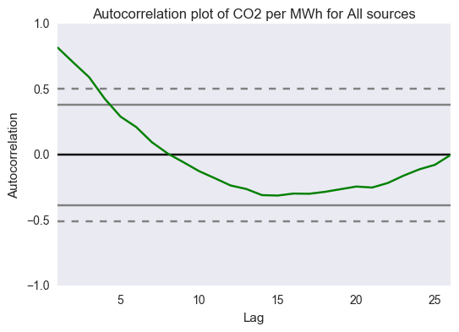
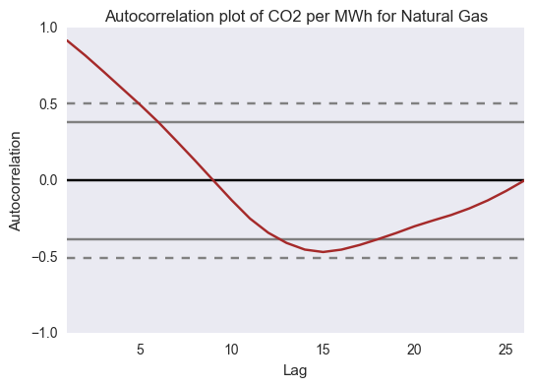
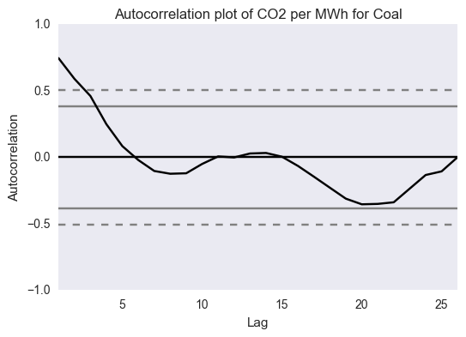
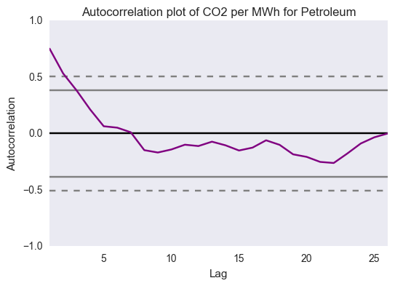
Autocorrelations
Total Sources and Natural Gas show the strongest autocorrelation pattern going back 10 years. Coal and, to a lesser extent, Petroleum show autocorrelation going back 4 to 5 years

Slide 17
Naïve AR(1), ARMA and ARIMA
As a naïve trial, ran AR (1) using the entire 26 year history for each high CO2 efficiency source and note the non-stationary results:
The residuals do not appear randomly distributed with same spikes for all sources. Therefore, ran naïve ARIMA:
 | AR(1) Coef | SE
Total Sources | 0.9807** | 0.025
Natural Gas | 0.9912** | 0.012
Coal | 0.9080** | 0.087
Petroleum | 0.7773** | 0.118
Geothermal | 0.9488** | 0.056
 | (p, d, q) | AR(1) | AR(2) | MA(1) | MA(2)
Total Sources | (1, 1, 1) | -0.6808** | _ | 1.0000 | _
Natural Gas | (1, 1, 1) | 0.5747** | _ | 0.3418 | _
Coal | (1, 1, 1) | -0.6788** | _ | 1.0000** | _
Coal | (1, 1, 2) | 0.3567 | _ | -0.3931 | -0.6069**
Petroleum | (2, 1, 1) | -0.0016 | -0.2606 | -0.1963 | _
Geothermal | (1, 0, 1) | 0.916** | _ | 0.2164 | _
Notes:
Residuals show some odd patterns with spikes for Natural Gas, Geothermal and Coal. For Natural Gas, particular concern around spike around 2001. For Geothermal, odd flat residuals between 2000 and 2010. For Coal, there are some fluctuations, however, the scale is tight and we can say the residuals follow a random pattern.
For Geothermal energy, given the constant CO2 emissions per MWh observed between 1999 and 2010, detrending is not required to perform the ARIMA on the entire 25 year history. This is despite, the increasing trend in CO2 emissions per MWh observed for Geothermal since 2010. Therefore, an ARIMA (1,0,1) or ARMA model is applied for the Geothermal.
The ARIMA(1,1,1) model on Coal indicates that forecasted 2016 value for CO2 emissions per MWh decreases by -.6788 from the 2015 value. The coefficient on MA is significant and indicates that residuals can be influencing the results.

Slide 18
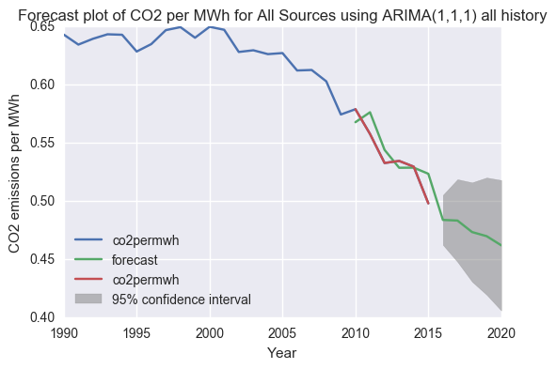
Predictions of naïve ARIMA
The naïve ARIMA on Total Sources predicts a decreasing trend in CO2 efficiency going over the future 5 years (2016-2020)
However, is not a perfect performer as seen from the differences between the actual and predicted value over the last 6 years (2010-2015)
Notes:
Residuals show some odd patterns with spikes for Natural Gas, Geothermal and Coal. For Natural Gas, particular concern around spike around 2001. For Geothermal, odd flat residuals between 2000 and 2010. For Coal, there are some fluctuations, however, the scale is tight and we can say the residuals follow a random pattern.
For Geothermal energy, given the constant CO2 emissions per MWh observed between 1999 and 2010, detrending is not required to perform the ARIMA on the entire 25 year history. This is despite, the increasing trend in CO2 emissions per MWh observed for Geothermal since 2010. Therefore, an ARIMA (1,0,1) or ARMA model is applied for the Geothermal.
The ARIMA(1,1,1) model on Coal indicates that forecasted 2016 value for CO2 emissions per MWh decreases by -.6788 from the 2015 value. The coefficient on MA is significant and indicates that residuals can be influencing the results.

Slide 19
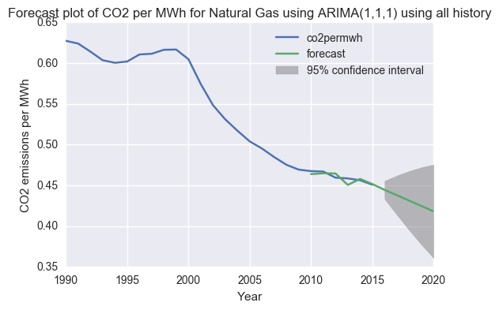
Predictions of naïve ARIMA
The naïve ARIMA on Natural Gas predicts a decreasing trend in CO2 efficiency going over the future 5 years (2016-2020)
Is a decent performer as seen from the differences between the actual and predicted value over the last 5 years (2011-2015)
Year | Actual | Prediction
2011 | 0.467 | 0.470
2012 | 0.459 | 0.467
2013 | 0.459 | 0.458
2014 | 0.456 | 0.457
2015 | 0.451 | 0.453

Slide 20
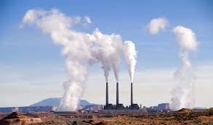
Train ARIMA on recent years
The naïve ARIMA models performed best on Total Sources and Natural Gas; however, spikes in residual plots leave better models to be desired.
Both Total Sources and Natural Gas showed almost monotonic trends in CO2 efficiency since the early 2000s
Train ARIMA models on the post-2001 period and test only most recent values to evaluate performance
For Total Sources data, train models on data from 2002 -2012 and test on post-2013 data
For Natural Gas data, train models on data from 2001 -2012 and test on post-2013 data

Slide 21
Train ARIMA on recent years
Total Sources:
AR(1) model performed best
ARIMA(1,1,1) produced a low MAE, but an insignificant AR coefficient.
Natural Gas:
AR(1) model performed best
ARIMA(1,1,2) produced a high, significant AR coefficient, yet higher MAE
 | (p, d, q) | AR(1) | MA(1) | MA(2) | Mean absolute error (MAE)
Total | (1, 0, 0) | 1.0000 | _ | _ | 0.0132
Total | (1, 1, 1) | 0.7491 | -1.000** | _ | 0.0132
Total | (1, 1, 2) | -0.2247 | 1.368e07 | -1.000 | 0.5225
Total | (1, 1, 0) | -0.2051 | _ | _ | 0.5294
Natural Gas | (1,0,0) | 0.9722** | _ | _ | 0.0072
Natural Gas | (1,1,1) | 0.6636** | 0.9995* | _ | 0.4679
Natural Gas | (1,1,2) | 0.9531** | 2.824e-08 | -1.000** | 0.4673

Slide 22
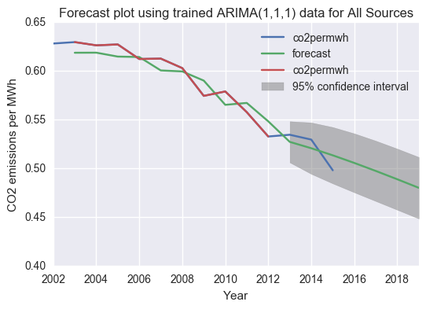
Predictions of trained ARIMA
The trained ARIMA (1,1,1) on Total Sources predicts a decreasing trend in CO2 efficiency going over the future 5 years (2016-2020)
However, is again not a perfect performer as seen from the differences between the actual and predicted value over the test period (2013-2015)

Slide 23
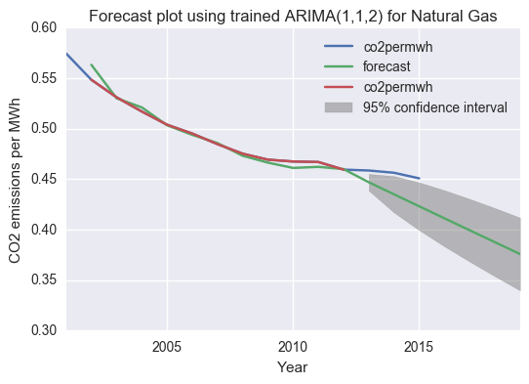
Predictions of trained ARIMA
The trained ARIMA (1,1,2) on Natural Gas predicts a decreasing trend in CO2 efficiency going over the future 5 years (2016-2020)
Decent performer as seen from the differences between the actual and predicted value over the test period (2013-2015)

Slide 24
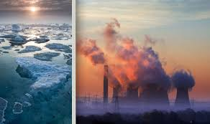
Conclusions
Autoregressive modeling methods are most useful for making predictions on time series data that show trending declines or increases
It is very difficult to predict values when this is not the case
The Total Sources and Natural Gas data showed best performance given that recent values in CO2 efficiency appear to be trending in a auto-dependent fashion since the early 2000s
CO2 efficiency of Coal, Petroleum and other sources are more difficult to model given the volatile changes in CO2 patterns over time
ARIMA on Coal likely to perform better on post-2007 data – hopefully
Notes:
Residuals show some odd patterns with spikes for Natural Gas, Geothermal and Coal. For Natural Gas, particular concern around spike around 2001. For Geothermal, odd flat residuals between 2000 and 2010. For Coal, there are some fluctuations, however, the scale is tight and we can say the residuals follow a random pattern.
For Geothermal energy, given the constant CO2 emissions per MWh observed between 1999 and 2010, detrending is not required to perform the ARIMA on the entire 25 year history. This is despite, the increasing trend in CO2 emissions per MWh observed for Geothermal since 2010. Therefore, an ARIMA (1,0,1) or ARMA model is applied for the Geothermal.
The ARIMA(1,1,1) model on Coal indicates that forecasted 2016 value for CO2 emissions per MWh decreases by -.6788 from the 2015 value. The coefficient on MA is significant and indicates that residuals can be influencing the results.

Slide 25
Future considerations
Future problems to pursue with available data
Predict trends for other emissions types (SO2 and NOx)
Predict emissions outputs by state
Identify shifts in contribution to national-level emissions by state and sources within state
Other data to consider including
Price data on energy sources over time
Indicators for emissions standards programs by state/region
Future problems to pursue with other data
Use price data to predict emissions outputs
Use emissions standards indicators to identifying shifts in contribution to emissions by source and state

Slide 26
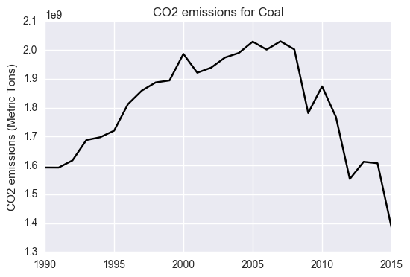
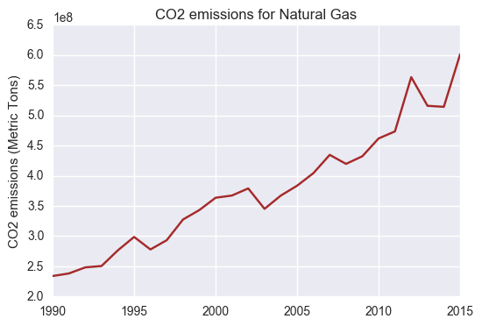
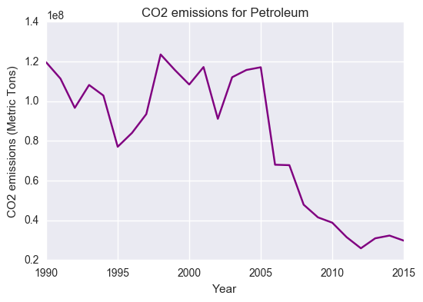
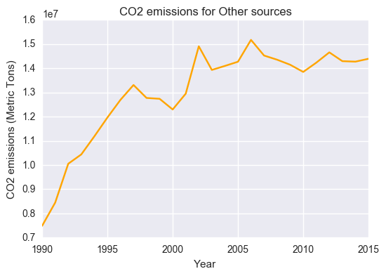
Appendix: CO2 emissions trends by source

Slide 27
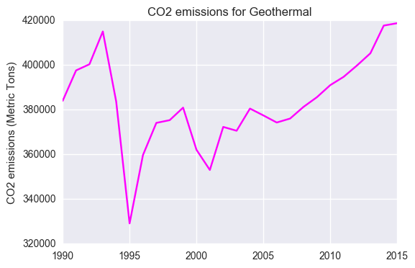
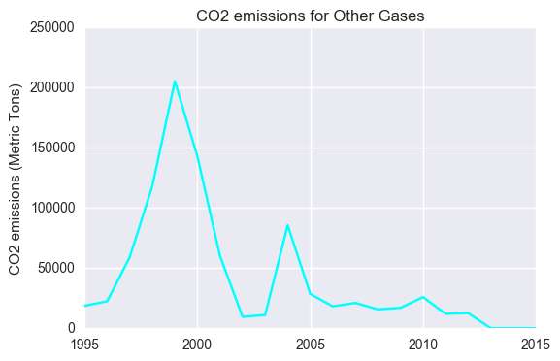
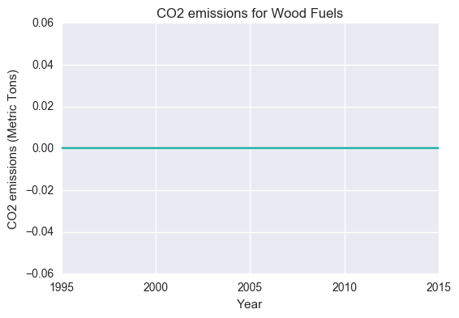
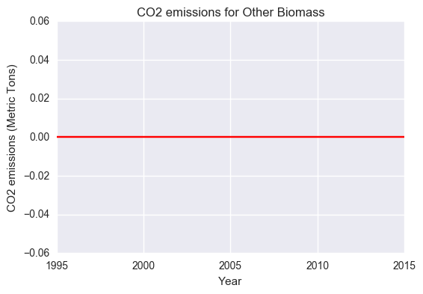
Appendix: CO2 emissions trends by source

Slide 28
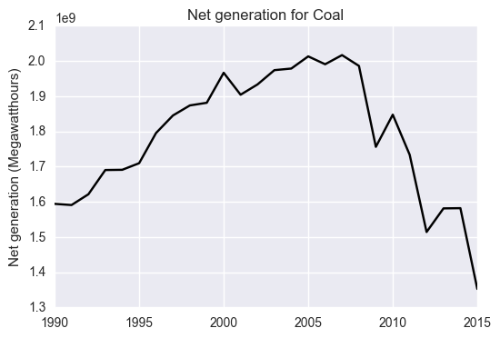
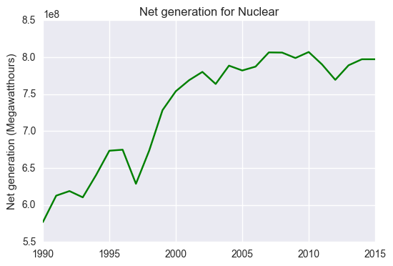
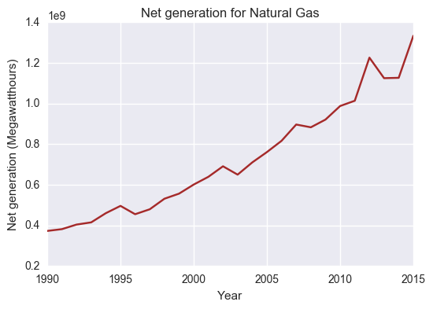
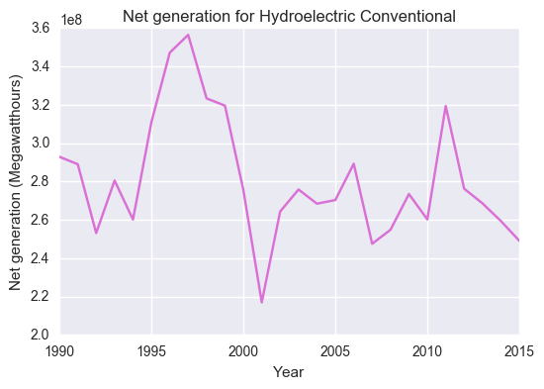
Appendix: Net generation trends by source

Slide 29
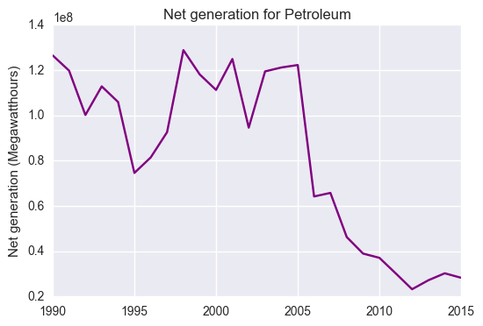
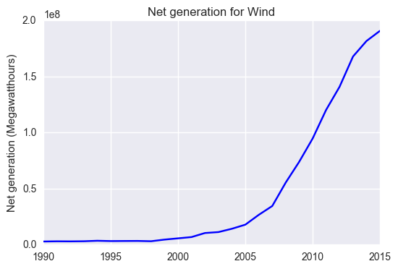
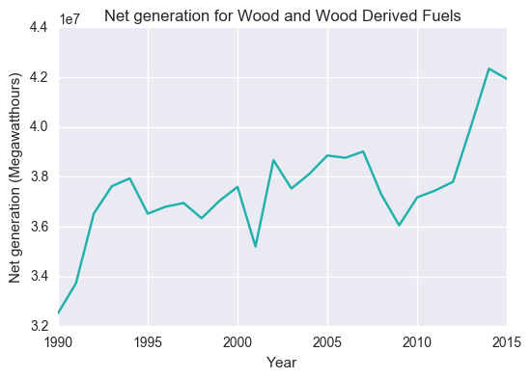
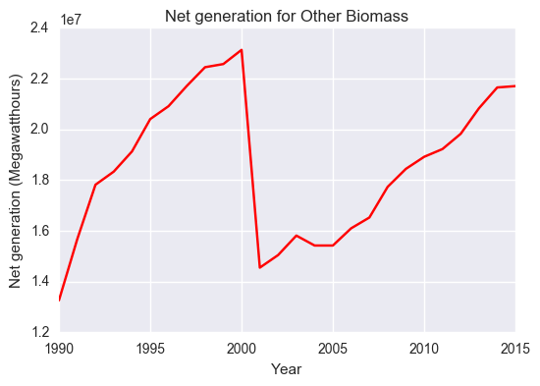
Appendix: Net generation trends by source

Slide 30
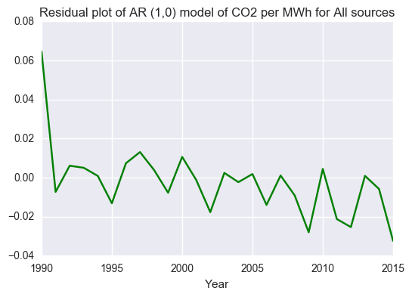
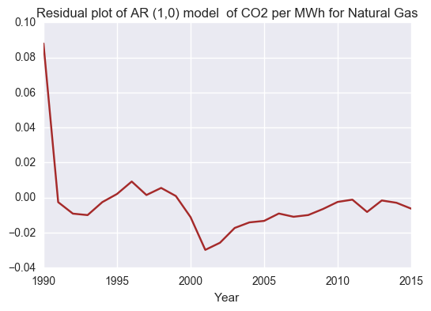
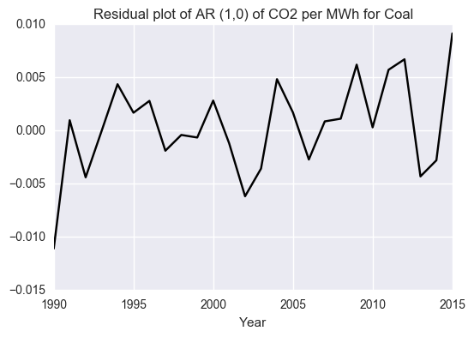
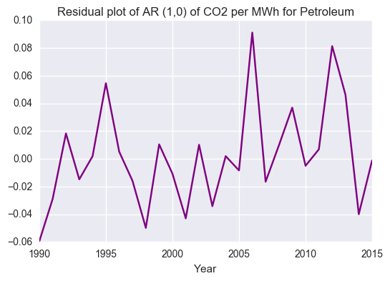
Appendix: Residual plots of naïve AR(1) models
Notes:
Residual plots of AR models indicate that residuals follow a random pattern for All Sources; however, residuals show some odd patterns with spikes for Natural Gas, Geothermal and Coal. For Natural Gas, particular concern around spike around 2001. For Geothermal, odd flat residuals between 2000 and 2010. For Coal, there are some fluctuations, however, the scale is tight and we can say the residuals follow a random pattern.

Slide 31
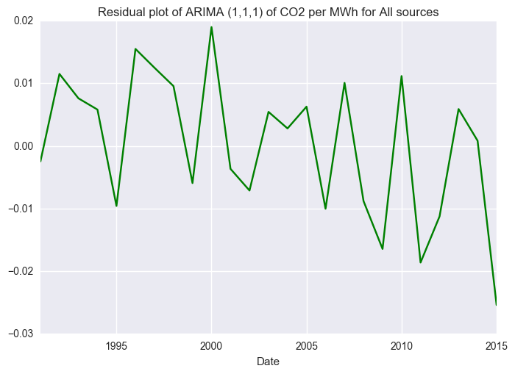
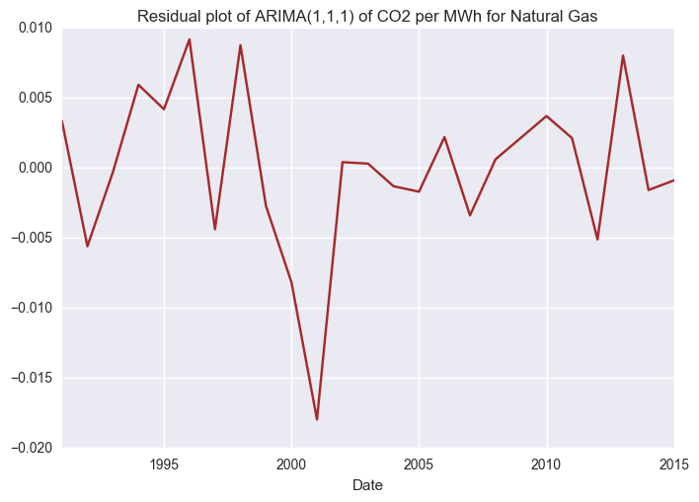
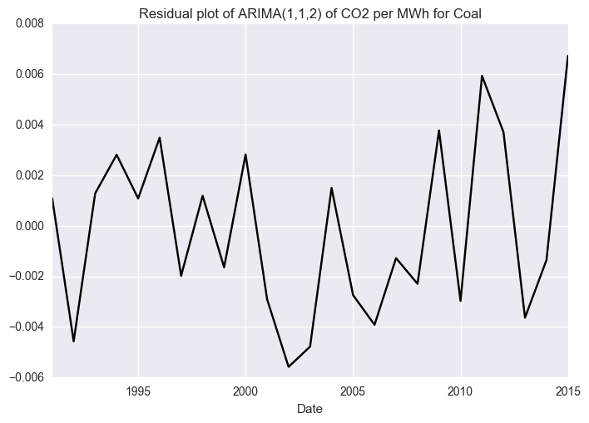
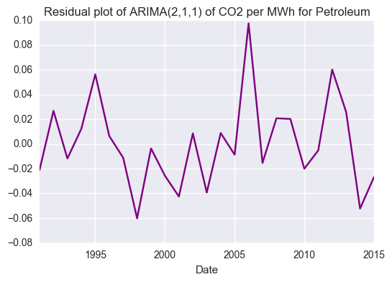
Appendix: Residual plots of naïve ARIMA models
Notes:
Residual plots of ARIMA models indicate that residuals follow a random pattern for All Sources; however, residuals show some odd patterns with spikes for Natural Gas, Geothermal and Coal. For Natural Gas, the particular concern is around the downward spike in residuals around 2001, although the residual trend is random thereafter. For Geothermal, odd flat residuals between 2001 and 2010. For Coal, there are fluctuations in both directions, using both the ARIMA (1,1,1) and ARIMA(1,1,2) models.

Slide 32
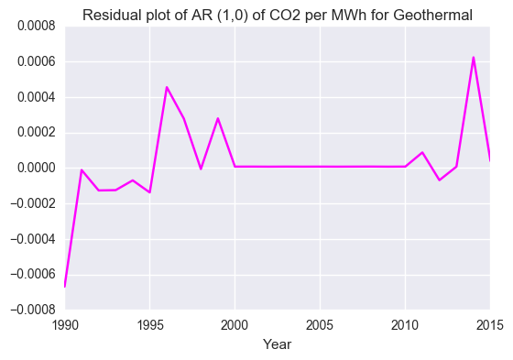
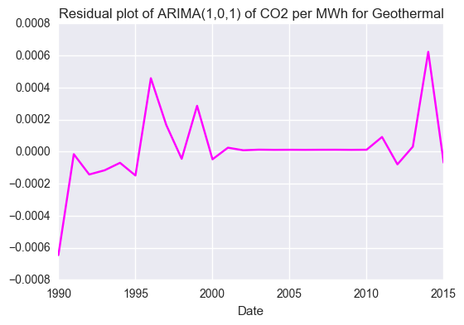
Appendix: Residual plot of naïve AR(1) and ARMA(1, 1) models on Geothermal data
Notes:
Residual plots of ARIMA models indicate that residuals follow a random pattern for All Sources; however, residuals show some odd patterns with spikes for Natural Gas, Geothermal and Coal. For Natural Gas, the particular concern is around the downward spike in residuals around 2001, although the residual trend is random thereafter. For Geothermal, odd flat residuals between 2001 and 2010. For Coal, there are fluctuations in both directions, using both the ARIMA (1,1,1) and ARIMA(1,1,2) models.

Slide 33




Appendix: Residual plots of trained ARIMA models
Notes:
The above ARIMA(1,1,2) and ARIMA(1,1,0) models on the post-2002 to 2012 training set are not predictive. The AR(1) coefficient is insignificant and the MA coefficients are significant in the case of the ARIMA(1,1,2) model, indicating residuals remain influential. Moreover, the mean absolute error of the model increases to above .52 for each of these alternative ARIMA models.
Amongst the models attempted above, the best performer turned out to be the AR(1) model given the significance of the AR coefficient and the low mean absolute error of the model. The ARIMA(1,1,1) also produced a similarly low mean absolute error, but an insignificant AR coefficient.

Slide 34



Appendix: Residual plots of trained ARIMA models
Notes:
Amongst the models attempted above, the best performer turned out to be the AR(1) model given the significance of the AR coefficient and the low mean absolute error of the model. The ARIMA(1,1,1) produced a higher absolute mean error

